Slide 1
IOT BASED ELDERLY FALL DETECTION SYSTEM HEALTHCARE

Slide 2
BATCH NAME : MAGNETAR
NAME : SANJAY K, SUJITHKUMAR S M
DEPARTMENT : ECE
COLLEGE NAME : VELAMMAL INSTITUTE OF TECHNOLOGY

Slide 3
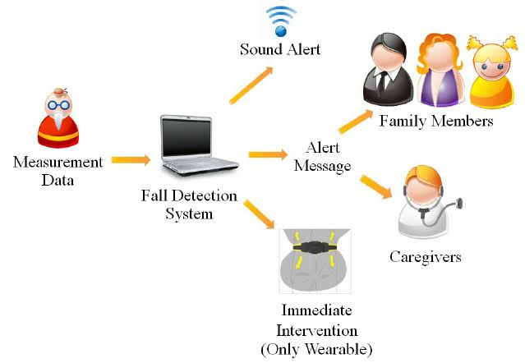
Introduction
🡪According to world health organization, people who aged above 65 there have some problems like poor sight, weakness , medicine over dosage so they may fall easy.
🡪According to world health organization, people who aged above 65 there have some problems like poor sight, weakness , medicine over dosage so they may fall easy.
🡪Yearly 646k Nearly 35% of people suffer from this it increases each year this leads to severe injuries even dead.
🡪 When falling there are no one nearby to help. The aim is to find a solution by alerting nearby about the fall.
🡪 This device is found to prevent the mortality rate of civilians as even some people have been died due to heavy mortality rate .
🡪About the device details given in the next page as abstract

Slide 4
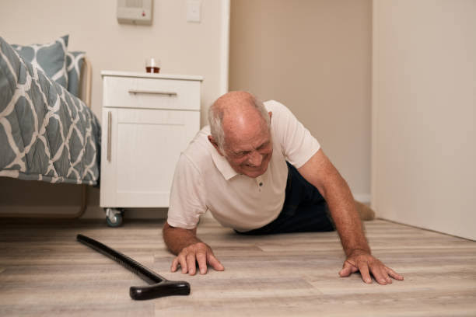
ABSTRACT
Falling down is the most common among elderly people . Medical attention needs to be provided promptly in order to reduce risk of victim.
This project proposed a fall detection system which is cost effective and reliable to detect fall and alert relatives or neighbor for help.
Based on body tilt of the faller the accelerometer coupled with gyroscope will send a alert message in the form of SMS (“I HAVE FELL DOWN”)
As a result this alert system has sensitivity and specificity of 95% and 90%.So this method will restrict the false alarm due to frequent swinging and movement of device

Slide 5
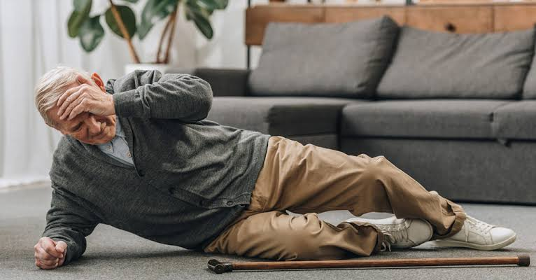
Literature survey 1
TITLE: An Enhanced Fall Detection System for Elderly Person Monitoring using Consumer home networks
Jin Wang, Member, IEEE, School of Computer and Software, Jiangsu Engineering Center
of Network Monitoring, Nanjing University of Information Science & Technology,
210044, China
Methods: wearable device based methods, vision based methods, and
ambient based methods.
Advantages:
There used image processing to detect and more algorithm is used.
Disadvantages:
Expensive so normal person cannot afford
Some false alarm is given
Accuracy level is not mentioned

Slide 6
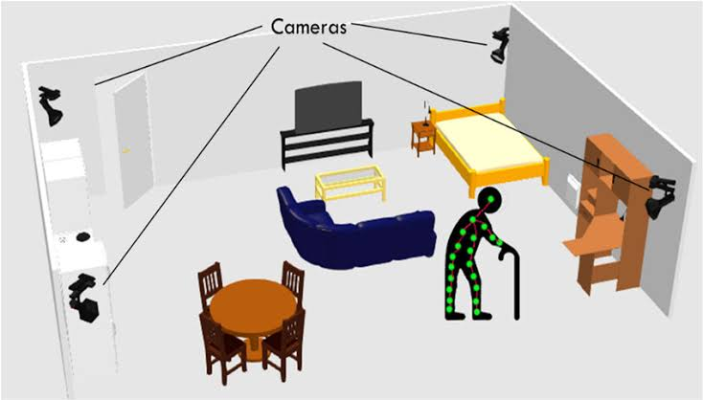
Existing methods
Image processing
Deep learning
Machine learning
Accelerometer sensor
Electromyography
These are the methods which is used in fall detection system image processing and deep learning are the two main methods are majority of countries till now.

Slide 7
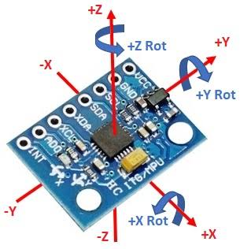
PROPOSED METHOD:-
1. Gyroscope senor can be used to detect the angular momentum and velocity and it also has acceleration calculation. Gyroscope consists of three axes x,y,z in which the possibilities of fall happens in +x,-x,+z and -z direction.
2. To detect the fall a demo of fall is done by which the threshold value is set for the equipment for better accuracy.

Slide 8
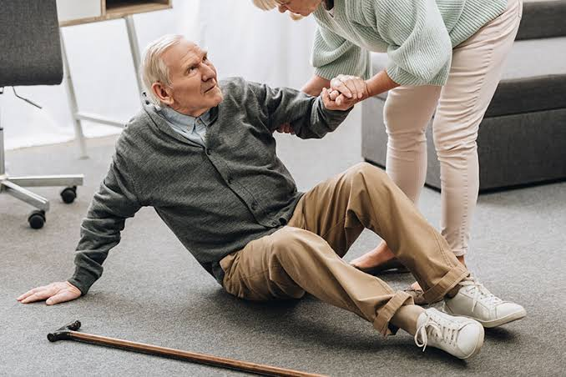
Objective
The main aim is to find a solution to Alert neighbor or family member or nearby hospital about old people fall.
It must be cost efficient.
More accuracy.
It should not create any interruption to the user while using.

Slide 9
Block diagram
ARDUINO NANO
Gyroscope sensor
GPS tracker
Vibration sensor
Message or pre recorded call
Alarm system
Neighbors and hospital Phone

Slide 10
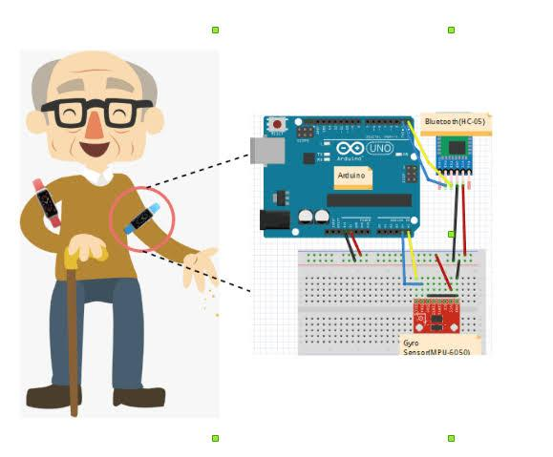
Applications
Detection of fall by 65 above people
Disabled people fall can be detected
To detect fall of people go to unconscious state
Death and mortality due to injury can be prevented
Easy to carry and also weightless
Durability and cost efficient
Using high accuracy sensor so easy to find fall

Slide 11
Summary
We first get values from accelerometer and gyroscope senor if the value goes beyond the threshold value we set then it checks the leveler capsule sensor if the output of capsule is high it triggers the alarm to alert nearby person to switch off the alarm if no person is nearby it sends message or pre recorded call to the family members if no response by checking the severe of the person it call or message to the hospital for help . Sometimes alarm people will think of its not serious so we can make the alarm to program it to shout
“Help”

Slide 12
Our inspiration
to help!!!
Thank you!!

